Slide 1
PRINCIPLES OF ECONOMICS
Salimah Musharrif
FPEC 101 – LECTURE 3 Unit 1

Slide 2
Demand and Supply Analysis

Slide 3
Outline
Demand
Supply
Shifts
Equilibrium

Slide 4
Market
The price mechanism refers to the determination of price through the market forces of demand and supply. Prices act as signals for producers to show them what to produce and how to use their scarce resources. Resources are diverted to the production of those goods which are in demand as they will earn a greater profit.
A market in the true economic sense is any effective arrangement where buyers and sellers come in contact with one another for the purpose of making transactions.

Slide 5
Demand
Demand is the quantity of a product that consumers are
  Willing to buy
  Able to buy
  At a price
  Over a period of time

Slide 6
The Law of Demand – inverse relation between price and Qd.
When goods are cheap, people buy more
When Price falls , quantity demanded increases
When goods are expensive, People buy less
When Price rises , quantity demanded falls

Slide 7
Law of Demand
“The Law of demand states that price and quantity demanded have a negative or inverse relationship. As price increases, quantity demanded decreases and vice Versa.” Ceteris paribus.
Consumption is subject to diminishing marginal utility. And because successive units of a particular product yield less and less marginal utility, consumers will buy additional units only if the price of those units is progressively reduced.
The income effect indicates that a lower price increases the purchasing power of a buyer’s money income, enabling the buyer to purchase more of the product than before. A higher price has the opposite effect.
The substitution effect suggests that at a lower price buyers have the incentive to substitute what is now a less expensive product for similar products that are now relatively more expensive. The product whose price has fallen is now “a better deal” relative to the other products.

Slide 8
Demand schedule
Price of computers | Quantity demanded per week
2000 | 1000
1800 | 2000
1600 | 3000
1400 | 4000
1200 | 5000
The Demand Schedule shows quantities demanded at given price.

Slide 9
The Demand Curve
The demand curve shows the quantity demanded at any given price.
D
2000
P
Price ($)
1800
Q
R
1200
D
1000
1200
5000
Quantity

Slide 10
Price
As the price changes, the quantity demanded will change. Movement along the curve.
D
0 10 20 30 40 50 60
D
0 1 2 3 4 5
Quantity

Slide 11
Individual Demand and Market Demand
Individual demand is the demand of just one consumer and is referred to as quantity demanded while the total demand for a product from all its consumers is known as market demand.
An important assumption that we make when discussing the factors that affect the demand is the ceteris paribus assumption. Under this assumption, we only discuss a change in one factor at a time.

Slide 12
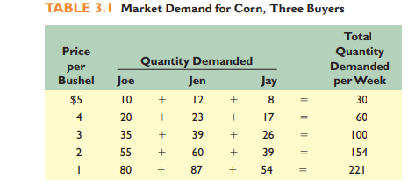
Individual Demand and Market Demand
Economics by Mc Connell & Brue pg 47
Difference between quantity demanded and demand
A change in price brings about a change in quantity demanded and is a movement along the curve.
A change in any other factor besides price will shift the curve so that more or less is demanded at the same price level. A change in price never brings about a movement or shift of the curve.

Slide 13
Demand - Shift
Shift in the demand curve
A change in any factor besides price will bring about a parallel shift, or movement of the entire demand curve. This means that more or less is demanded at each and every price level than they did before.
Factors affecting demand, conditions of demand, determinants of demand

Slide 14
Price
At the same price, a different quantity is demanded.
D
D1
D2
0 10 20 30 40 50 60
D1
D
D2
Quantity
0 1 2 3 4 5 6 7

Slide 15
Factors of Demand
Income
Population
Expectation of future price changes
Taste & Fashion
Prices of Related
Goods
Govt policies
Economic situation
Advertising
Other factors

Slide 16
LAW OF SUPPLY
“This is the producers willingness and ability to sell a product at a given price over a given period of time .” It refers to the amount producers are willing to create and sell at a given price level. Existing stocks are not considered supply unless they are put up for sale.
A firm interested in profit will only make and sell a product if it can do so at a price over and above what it cost the firm to make. Hence, the higher the price, the more the firm is willing to supply because it expects more profits.
The Law of supply states that price and quantity supplied have a positive or direct relation. As price increases quantity supplied increases and vice Versa.”

Slide 17
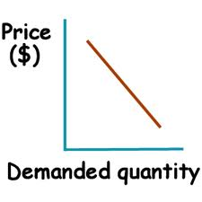
LAW OF SUPPLY
Price increases, quantity Supplied increases
Price decreases, quantity Supplied decreases
S
S

Slide 18
SUPPLY
Individual Supply - the supply of one Firm/ Producer
Market Supply is the total Supply of the Market
Difference between quantity Supplied and Supply
Just as we discussed for demand, it is important to remember that a change in quantity supplied is brought about by a change in price and is a movement along the curve. Any other factor changing besides a change in price brings about a shift of the curve. A change in price never brings about a movement or shift of the curve

Slide 19
SUPPLY
The Supply curve shows the quantity supplied at any given price.
200
S
160
Price
120
80
40
0
10
20
30
40
500
60
70
Quantity

Slide 20
Movement along Supply Curve
S
As the price changes, the quantity supplied will also change.
B
$30
Price
A
$15
1,250
1,500
Quantity

Slide 21
Shift of Supply Curve
S₂
S
S₁
At the same price, a different quantity is supplied.
Price
A
B
$15
1,250
1,500
Quantity

Slide 22
Determinants
Taxes
Subsidies
Producer expectation of price
Taste & Fashion
Cost of Production
Technology
Prices of other goods
Number of sellers

Slide 23
Functions of Price Mechanism
Allocate: The market mechanism allocates scarce resources.
Ration : price serve to ration scarce resources when demand outstrips supply.
Signal : Market prices adjust to demonstrate where resources are required, and when they are not.
Incentive : When the price of a product rises, the quantity supplied increases, this is due to the incentive function.

Slide 24
EQUILIBRIUM
Demand = Supply → Equilibrium
Demand ≠ Supply → Disequilibrium
  Surplus = Supply > Demand
  Deficit = Demand > Supply
The point of intersection shows the equilibrium point ‘E’. At this point D=S=Qd=Qs=Q
It is also known as the market clearing price. At any other point the market will be in disequilibrium. This is the point where the market forces will come to rest and there is no tendency to change.

Slide 25
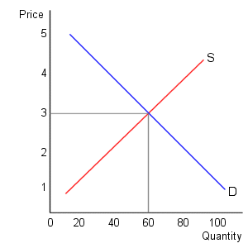
EQUILIBRIUM
Demand = Supply (Equilibrium Point)
P
E
Q

Slide 26
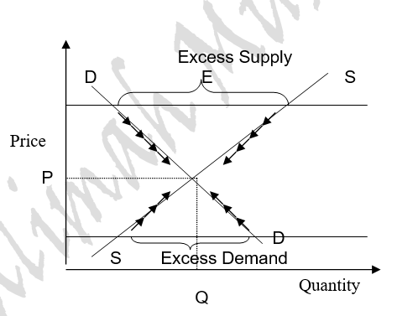
DISEQUILIBRIUM

Slide 27
MARKET FAILURE AND GOVERNMENT INTERVENTION

Slide 28
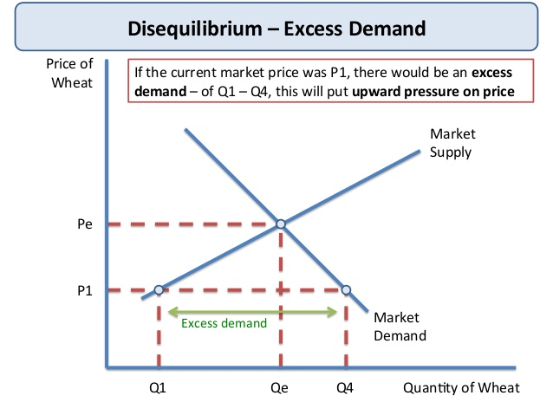
DISEQUILIBRIUM – EXCESS DEMAND
A price ceiling sets the maximum legal price a seller may charge for a product or service. A price at or below the ceiling is legal; a price above it is not.
When the ceiling price is below the equilibrium price, a persistent product shortage results.

Slide 29
DISEQUILIBRIUM- ED / SHORTAGE
Price ceilings are imposed by government on specific products, mostly necessities, to enable consumers to afford. Examples are rent controls and usury laws, which specify maximum “prices” in the forms of rent and interest that can be charged to borrowers.
Rationing Problem
Issuing ration coupons authorizing bearers to purchase a fixed amount of product monthly. These are then equitably distributed so that the wealthy family of four and the poor family of four both receive the same number of coupons.
Black Markets
Ration coupons may give rise to black marketing as many buyers are willing to pay more than the ceiling price and that is more profitable for the suppliers. A sizable enforcement bureaucracy would be required to ensure price controls.
Counterfeiting of ration coupons will be a problem.
Since government sets price, it might face political pressure to set an even lower price.
Example ceiling on rent. It may result in demand to increase but inadequate supply.
Resource Misallocation
In brief, controls distort market signals and thus resources are misallocated. Too few resources are allocated and too many alternative uses, eventually being the primary cause of such shortages.

Slide 30
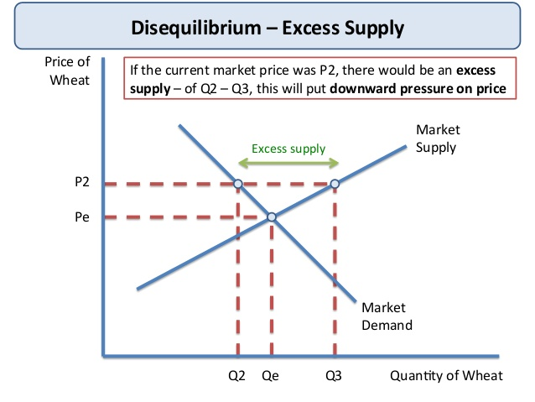
DISEQUILIBRIUM- EXCESS SUPPLY
A price floor is a minimum price fixed by the government. A price at or above the price floor is legal; a price below it is not. Usually for agricultural products. When the price floor is above the equilibrium price, a persistent product surplus results.

Slide 31
DISEQUILIBRIUM – ES/ SURPLUS
Price floors above equilibrium prices are usually invoked when society feels that the free functioning of the market system has not provided a sufficient income for certain groups of resource suppliers or producers. Supported prices for agricultural products and current minimum wages are two examples of price (or wage) floors
The government may cope with the surplus resulting from a price floor in two ways
Supply restriction
It can restrict supply or increase demand through alternative uses for the product, thus reducing the surplus.
Purchase excess stock
Government must purchase the surplus output at the adjusted price and store or otherwise dispose of it

Slide 32
DISEQUILIBRIUM – ES/ SURPLUS
Additional Consequences
Price floors also disrupt the rationing ability of prices as well as resource allocation. Without price floor producer would face losses and force high-cost wheat producers to plant other crops or abandon farming altogether. So society devotes too many of its scarce resources to wheat production and too few to producing other, more valuable, goods and services. It fails to achieve allocative efficiency.
Consumers of wheat-based products pay higher prices because of the price floor.
Taxpayers pay higher taxes to finance the government’s purchase of the surplus.
Price floor causes potential environmental damage through use of less suitable resources.
The higher price encourages imports but since such imports would increase the quantity of wheat supplied and thus undermine the price floor, the government needs to erect tariffs (taxes on imports) to keep the foreign wheat out. Such tariffs usually prompt other countries to retaliate.
Government controlled prices cause shortages or surpluses, distort resource allocation, and produce negative side effects.

Slide 33
Why the Equilibrium Changes?
  Change in Demand
  Change in Supply
  Change in Demand & Supply

Slide 34
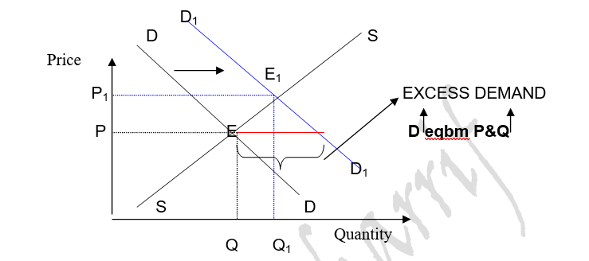
SHIFT IN DEMAND - INCREASE

Slide 35
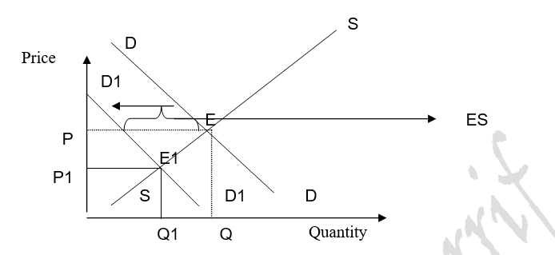
SHIFT IN DEMAND - DECREASE

Slide 36
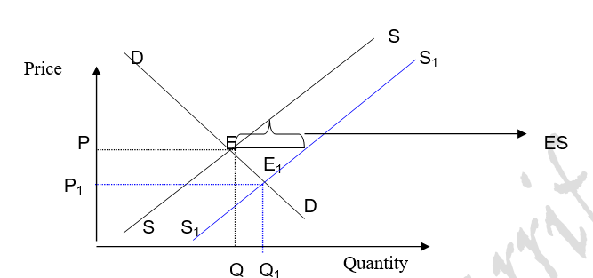
SHIFT IN SUPPLY - INCREASE

Slide 37
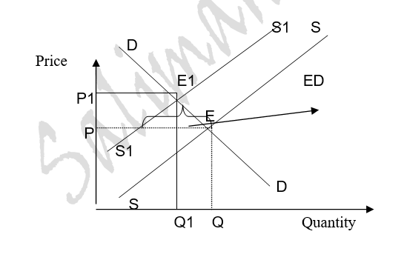
SHIFT IN SUPPLY - DECREASE

Slide 38
Outline
Demand
Supply
Shifts
Equilibrium
Disequlibrium

